Slide 1
HandTalk
Notes:
Descriptive title for project.
Names of group members

Slide 2
Scenario
Military special team mission
  Foggy, snowing, raining, and/or smoke-filled location.
  Their presence cannot be aware.
  Hand signals cannot be properly seen due to circumstantial conditions.
  How to communicate?
    Must be non-verbal and non-intrusive.
Notes:
Slide number

Slide 3
Scenario
Mute individual
  Trying to communicate with non-signing individuals.
  Writing?
    Time consuming.
    Somewhat obtrusive.
  How to communicate?
    Hand-signal interpretation.

Slide 4
Our Solution
Track and decode hand movement
Display it on an Android phone

Slide 5
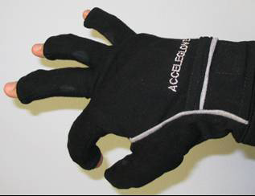
Current Technology: AcceleGlove
6 Accelerometers in the fingers and the back of the hand.
Pattern recognition software to identify static and moving gestures.
Current applications are limited to controlling robots or simulations.
Not specifically designed to use with military hand signals in combat type applications where low noise is required.

Slide 6
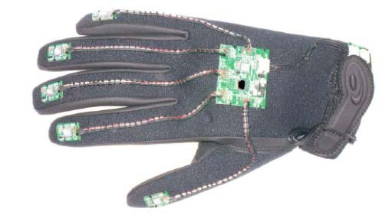
Current Technology: eGlove
Magnetic and Motion sensors for gesture recognition.
Also plans to have sensors to measure environmental factors such as temperature, sound, GPS, and optic information.
Incorporates the microprocessor on the glove to keep total product compact
Only simple gestures used for transmission of data using pointing gestures or similar movements

Slide 7
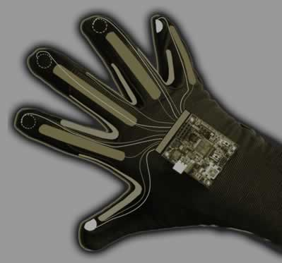
Current Technology:
Digital Smart Glove
Integrated sensor system to recognize independent hand and finger motions.
Monitors bending and motion of each digit, as well as overall motion of each hand.
Microprocessor embedded in glove to interpret signals.
Used for communication of commands between crew members, touchless selection of switches in aircraft, and communication across a low-bandwith battle network.

Slide 8
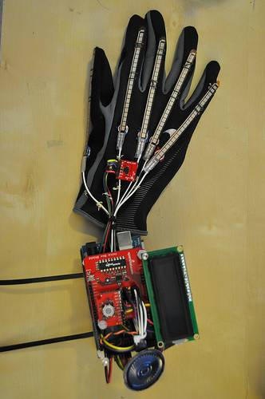
Current Technology: Sign Language Glove
Student design project that is used to translate American Sign Language (ASL) to English.
Glove use of flex sensors and an accelerometer to measure hand movements
Can recognize the letters of the alphabet and 10 ASL words
Words and letters signed by the user are displayed on the screen and also as “spoken” by the speaker
Entire system is worn on the wrist and hand of the user

Slide 9
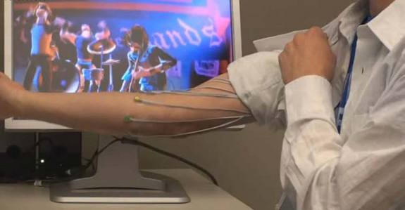
Current Technology: Microsoft EMG Project
Developed machine learning software so arbitrarily placed EMG sensors can be calibrated for gesture recognition and learning gestures
This software was able to learn how to play Guitar Hero

Slide 10
Achieved By: Glove or EMG
Glove Design
  Flex or pressure sensors combined with accelerometers worn on hand.
  This provides mapping of finger movement and hand motion
  Some work has already been done in this area.
EMG Design
  Use EMG sensors on upper arm to measure muscle activity.
  Eliminates need for glove, removes questions of durability, cleanliness and comfort.
  Very simple use of this tech to monitor large muscles such as biceps.

Slide 11
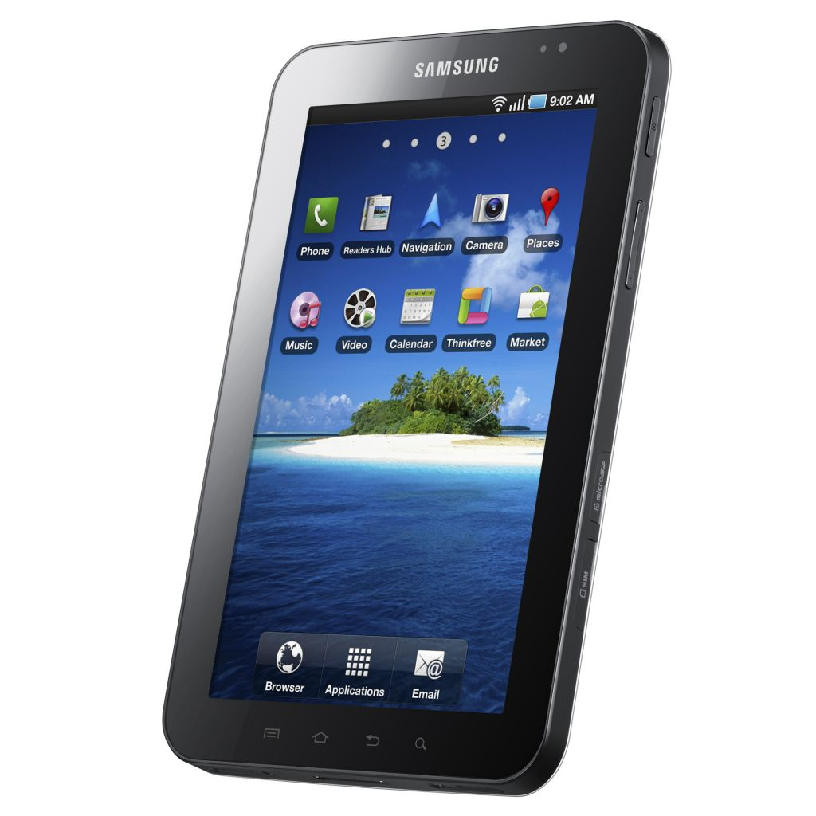
Enabling Technologies:
Android Devices
Provides a screen, audio devices, networking devices, processor, and other means of input and output all in one package.
Common accessory for anyone to carry around
Well documented. developmental tools and a large online community to support user-development.
Easy to make apps that are available to everyone on the Android Marketplace.

Slide 12
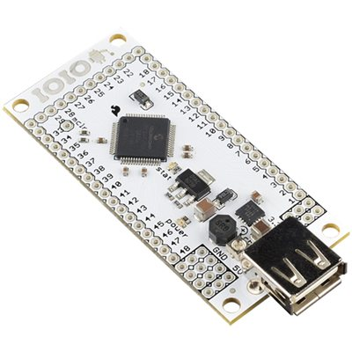
Enabling Technologies: IOIO
IOIO gives Android devices I/O pins to connect to other devices by the Android devices USB port.
Features:
  Requires no modification to the phone
  48 total I/O pins
  Up to 16 analog inputs
  Up to 9 PWM outputs
  Up to 4 UART channels
  Up to 3 SPI channels
  Up to 3 TWI (I²C-compatible) channels

Slide 13
Enabling Technologies: Sensors
Accelerometers
  Able to measure an objects direction and magnitude of proper acceleration, orientation, coordinate acceleration, vibration, shock, and falling
Gyroscopes
  Able to measure an objects orientation
Uses for both
  Using both Accelerometers and Gyroscopes gives enough information to calculate orientation, position, and velocity of an object
  Can be used to measure finger, hand, and arm movements

Slide 14
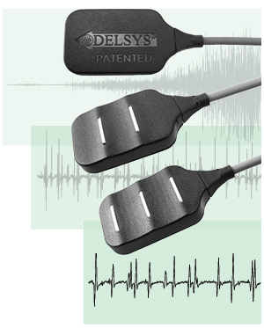
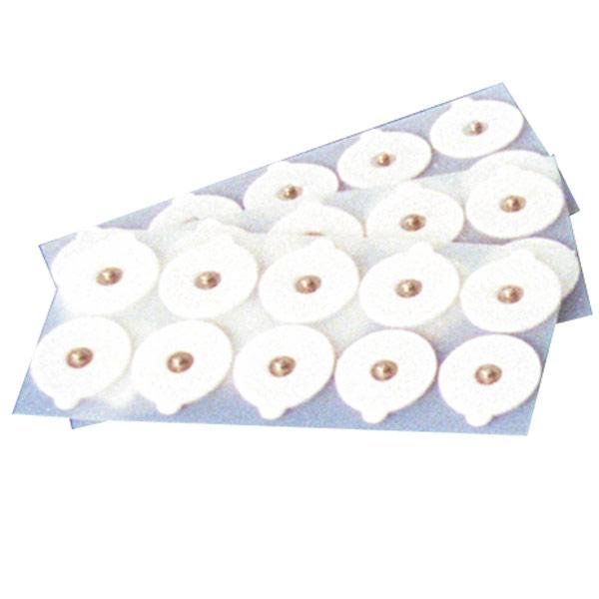
Enabling Technologies: EMG
Electromyography (EMG) measures electrical activity produced by skeletal muscles
Electrodes are placed on the surface of the skin that can monitor the general state of a given muscle
Electrodes come in reusable and disposable forms
Can be used to monitor finger, hand, and arm movements.

Slide 15

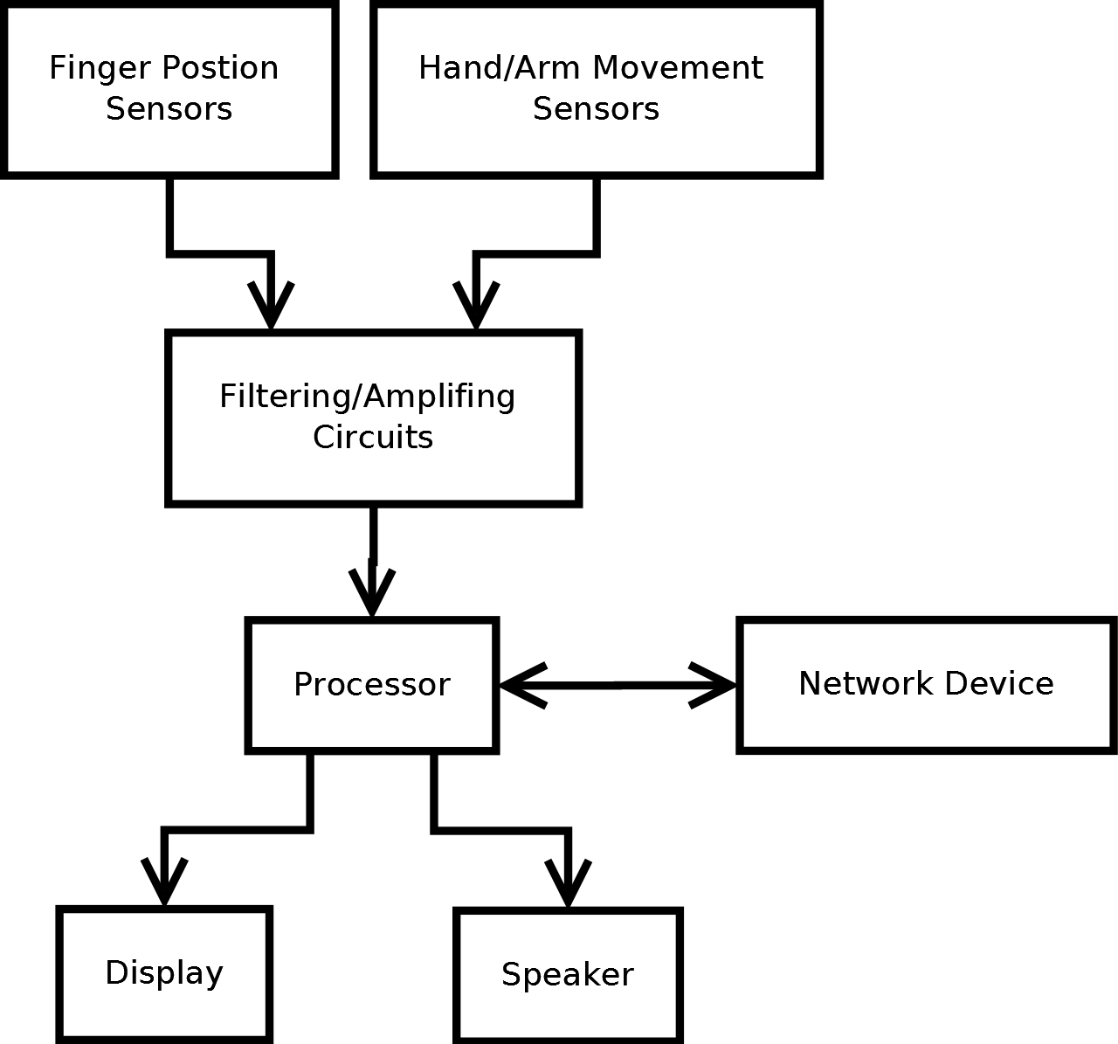
Wired implementation

Slide 16
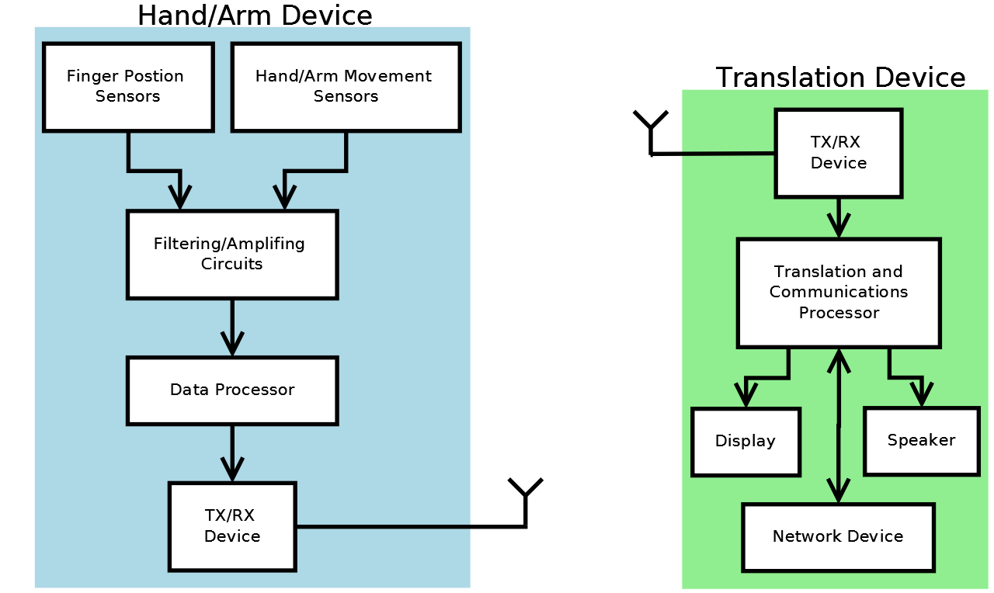

Wireless implementation

Slide 17
Future Applications
Military
Assisting Technologies
Public Services

Slide 18
Military
Tracking military hand signals
Deploying message over safe network (Team)

Slide 19
Assisting Technologies
Short-term
  Translate some hand signals into spoken or written language.
Long-term
  Fully allow mute individuals to communicate to non Signal Persons.

Slide 20
Public Services
Firefighters
  Smokey environments which require team work.

